Slide 1
Students Math Scores Linear Regression
Adrean Tejeda
Bana320

Slide 2
Step 1: Data/Business Understanding
Variables
Failures- Number of past class failures (Independent Variable)
Medu- Mothers Education (Independent Variable)
Goout- Going out (Independent Variable)
G3- Final Score (Target/ Dependent Variable)

Slide 3
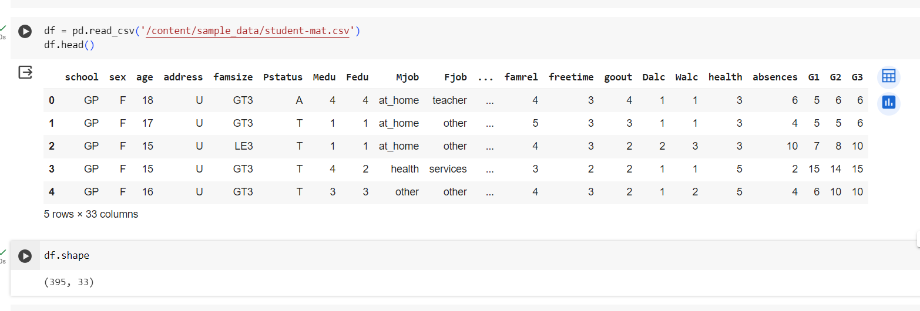
Step 2: Data preparation
‘GP’ Gabriel Pereira School , ‘MS’ Mousinho da Silveira
https://archive.ics.uci.edu/dataset/320/student+performance

Slide 4
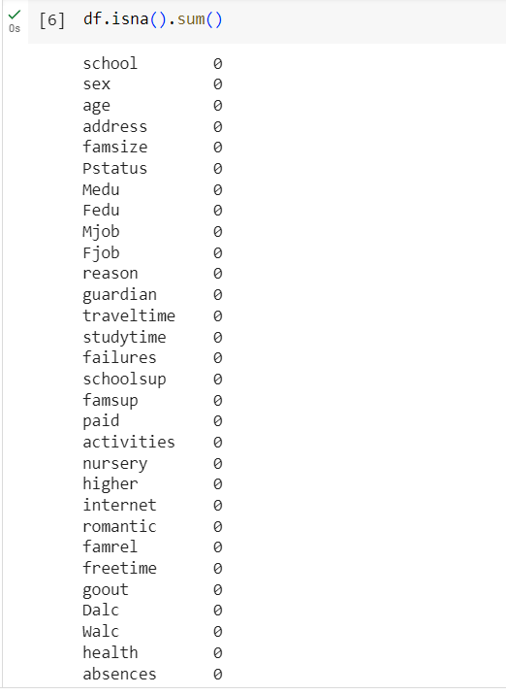
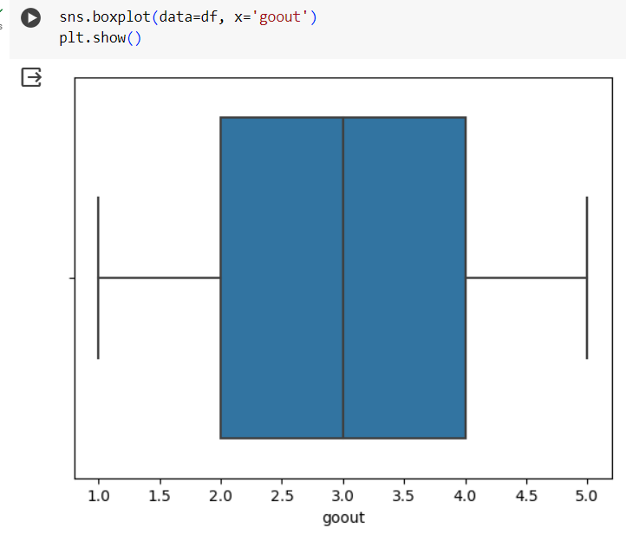
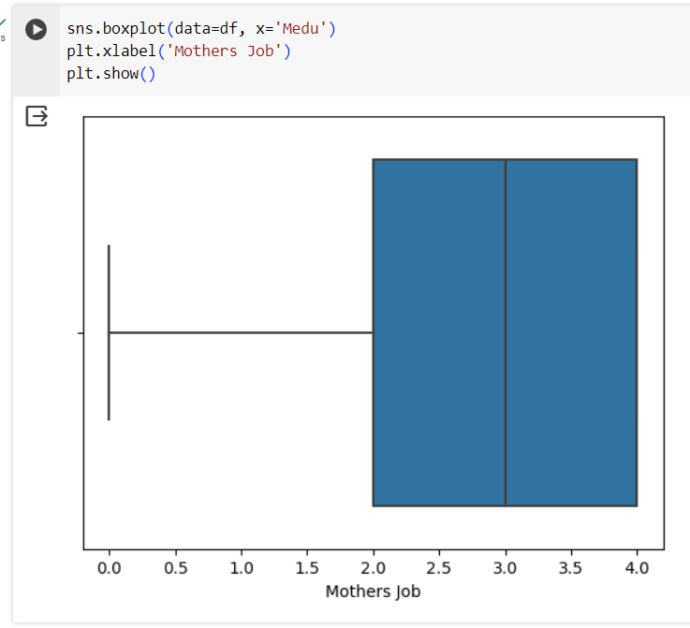
Step 2: Data preparation
Check for outliers
Check for missing data

Slide 5
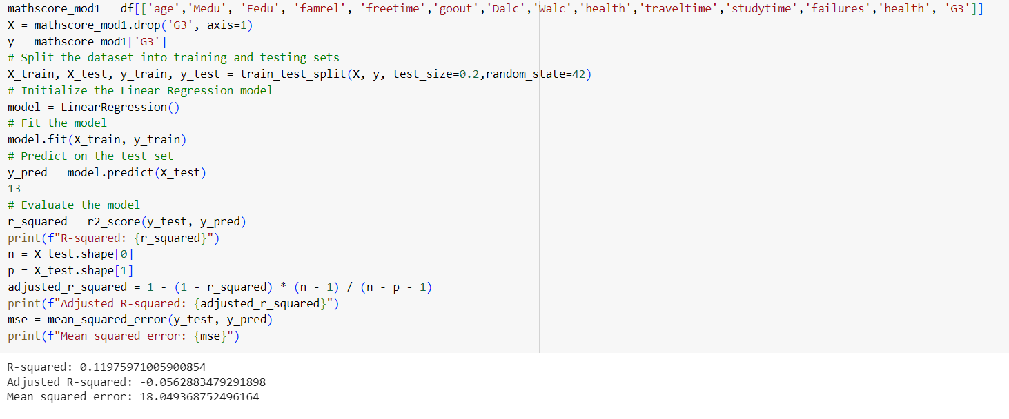
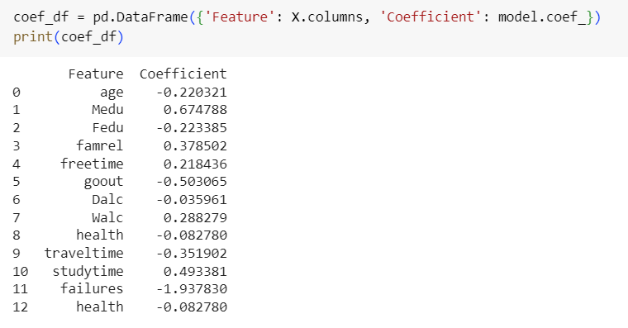
Step 3: Modeling Linear Regression

Slide 6
Step 3: Modeling
G3(Final Score)= Intercept -1.938 x failures +0.675 x mother education -0.503 x going out

Slide 7
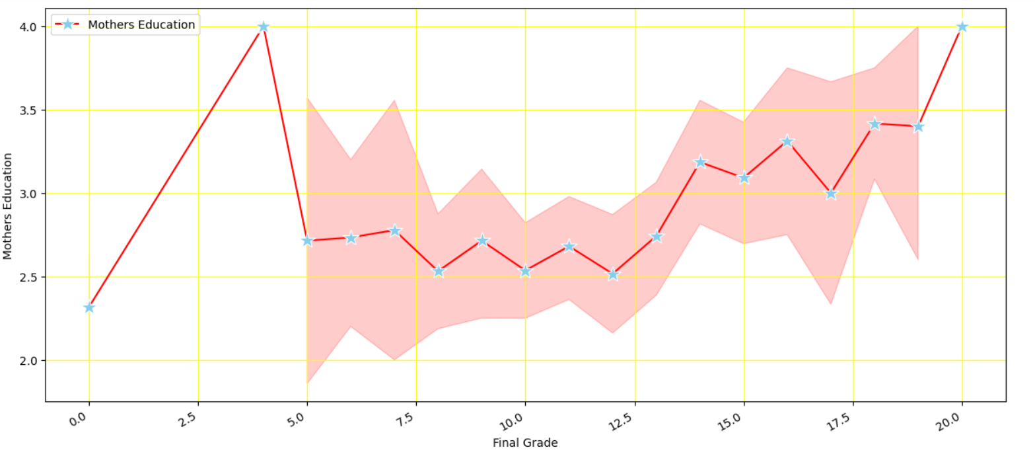
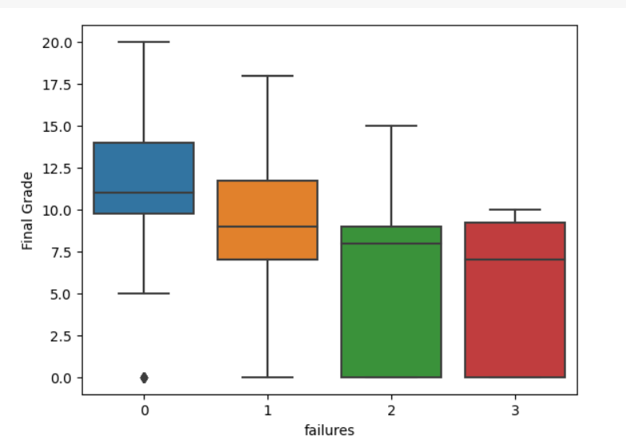
Step 4: Data Insights

Slide 8
Thank You!

